Slide 1
Getting started with github

Slide 2
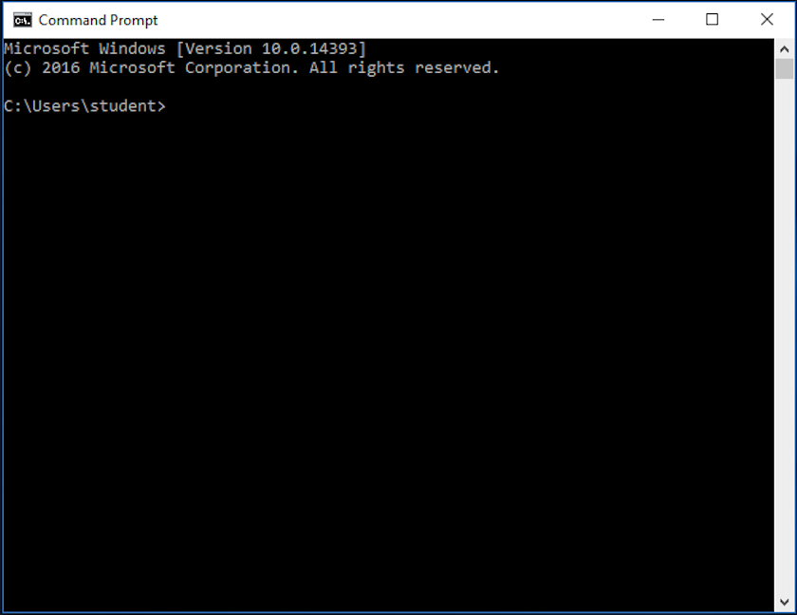
The black window
Misconceptions
Intimidating
Hard to learn
Notes:
1). People look at this black window and think it’s the scariest things in computers.
2). Thinks its complicated and it would take a great deal of time to use.

Slide 3
The black window
The Truth
Simple
Easy to memorize.
Notes:
1). It’s the same as navigating a computer without the GUI.
2). Most of the common commands are short

Slide 4
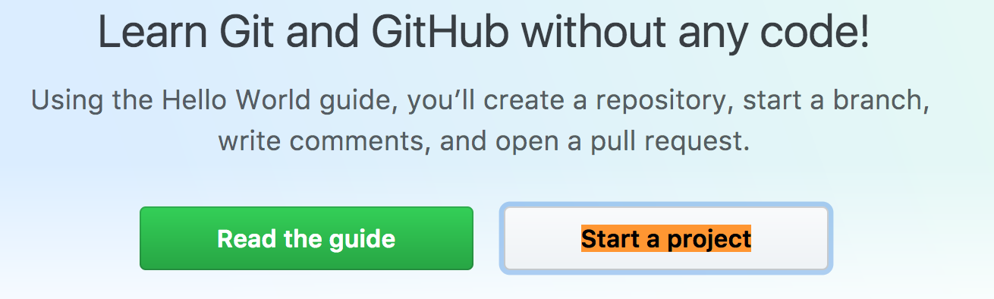
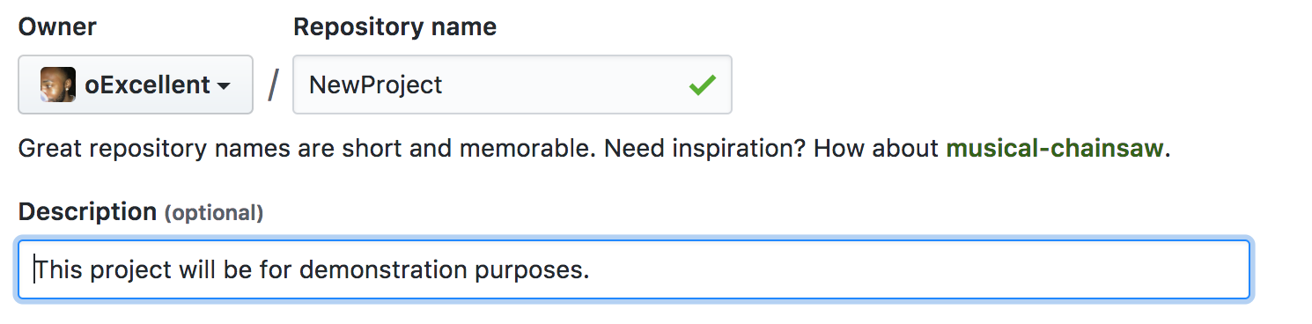


Starting a New project
Notes:
Granted you have an account and signed in.
1). Once you click the “Start a project” button you will end up at a page of the below image where you can add details of the project and confirm starting it.

Slide 5
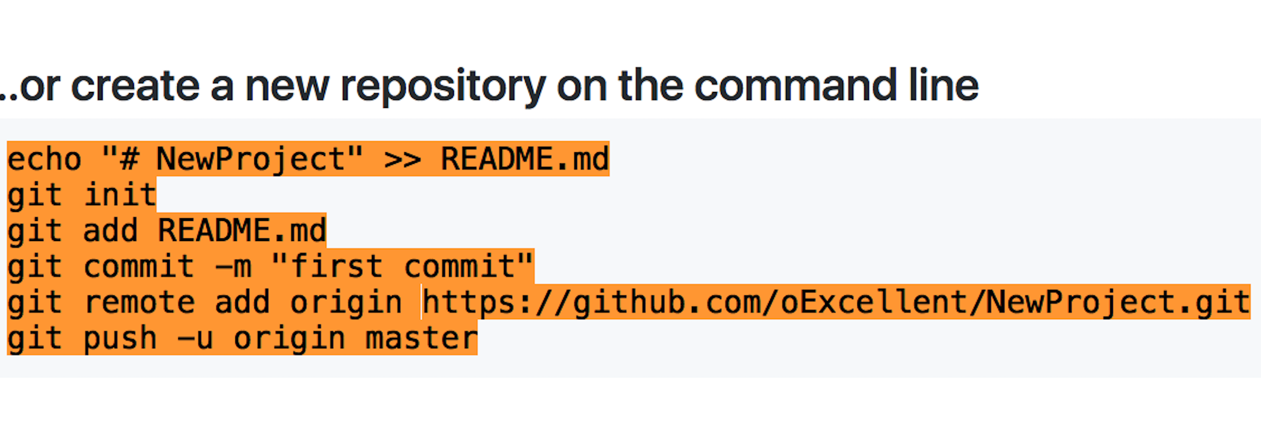
Starting a new Project
Notes:
1). You’ll end up at a page like this.

Slide 6
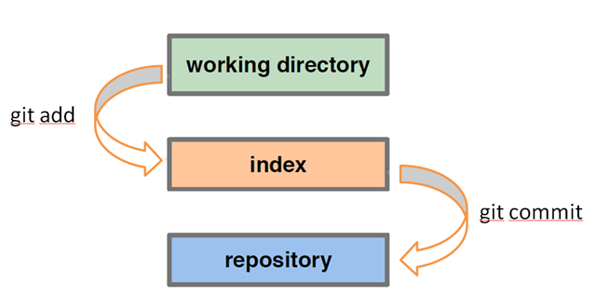
Git add
Git Add .
GIt Add “fileName.Extension”
Notes:
1). When you change things in your local project you must add them to the git hub index so that git hub knows on your next commit to add them to the repository.
2). Theres more than one way to git add.
3). Git add with a period adds all changes you have made.
4). Git add with a file name adds only changes mage to that file.

Slide 7

Git Pull
Stay up to date.
Don’t be that guy.
Notes:
1). One git pull command can determine if you will have to spend hours making your work conform to the newest update.
2). A lot of times people will forget to PULL and end up having to make up having outdated work on their project.

Slide 8
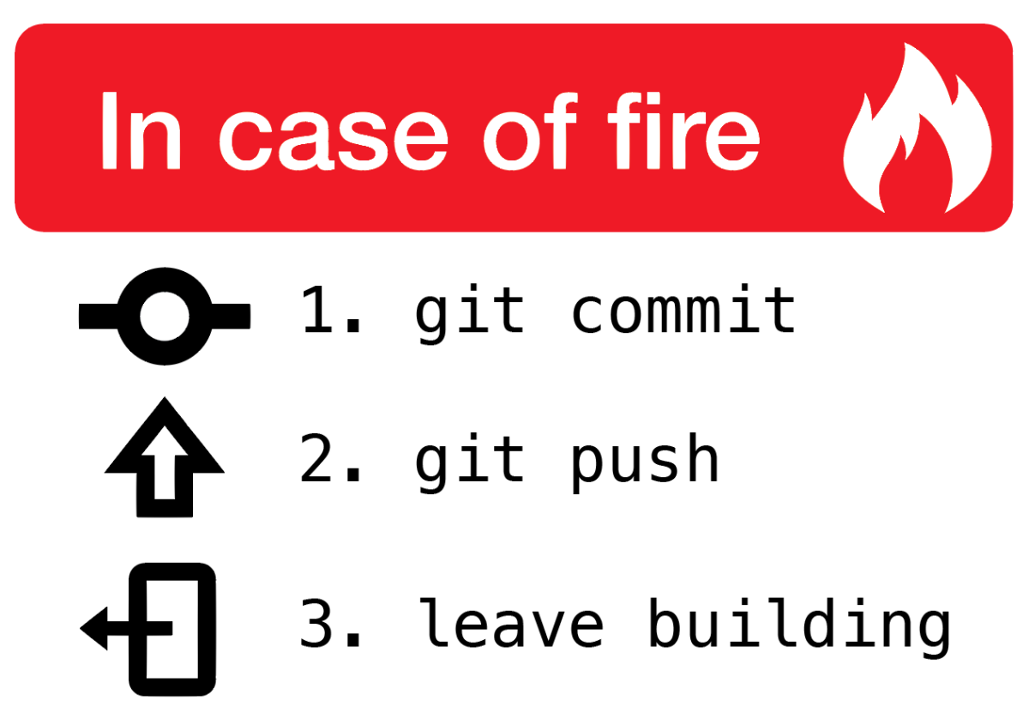
Git commit
Git commit –m “What I have changed”
Notes:
1). Committing is the same as adding your changes to a que, you want to get in the habit of making commits when you make a change
2). Add comments to your commit so people know what has been changed

Slide 9

Git push
Apply
Notes:
1). It doesn’t matter what you have done, how many times you have committed a change.
2). Un-Pushed changes will not reflect on your git-hub repository.

Slide 10

Useful commands
Status
Diff

Slide 11
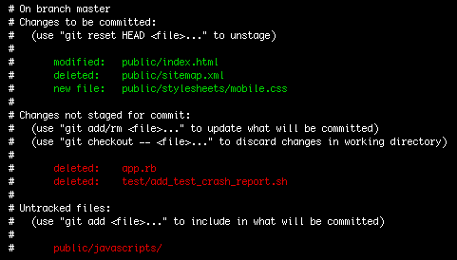
Git status
git status
Notes:
1). In this example you can see the files that have been added and those that have not
2). Any changes in red have not been staged for a commit, in other words git hub sees them but has not been told to apply them

Slide 12
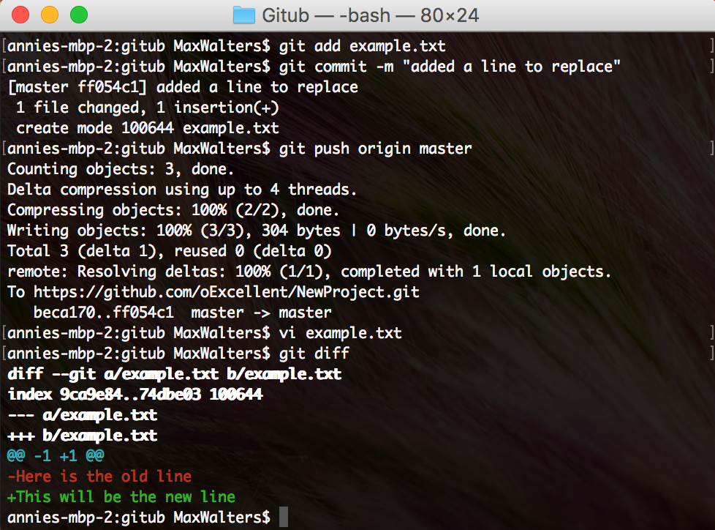
Git diff
See the difference.
Notes:
In real time you can see how your modified files differ from those on the repository.

